Slide 1
Chapter Four
Electric Potential
Our goals in this chapter are to
(1) define electric potential
(2) discuss how to calculate it for various arrangements of charged particles and objects, and
(3) discuss how electric potential V is related to electric potential energy U.

Slide 2

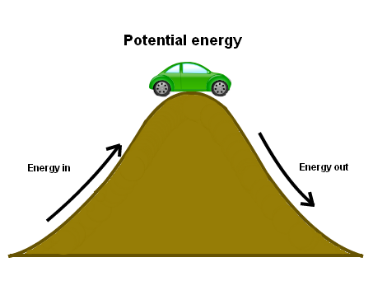
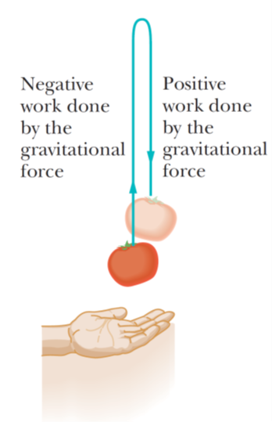
It is energy that can be associated with the configuration (arrangement) of a system of objects that exert forces on one another.
A tomato is thrown upward. As it rises, the gravitational force does negative work on it, decreasing its kinetic energy. As the tomato descends, the gravitational force does positive work on it, increasing its kinetic energy.
In case of upward moving, the gravitational force transfers energy from kinetic energy to the gravitational potential energy.
While for downward moving, gravitational force transfers energy from the gravitational potential energy to the kinetic energy.

Slide 3
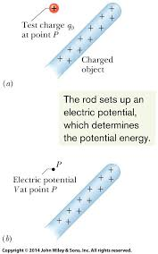
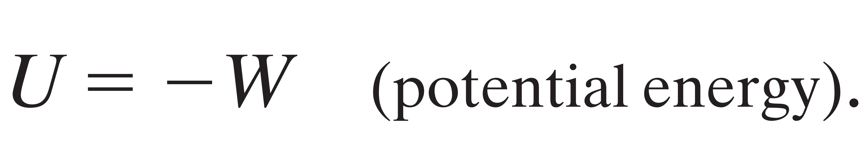
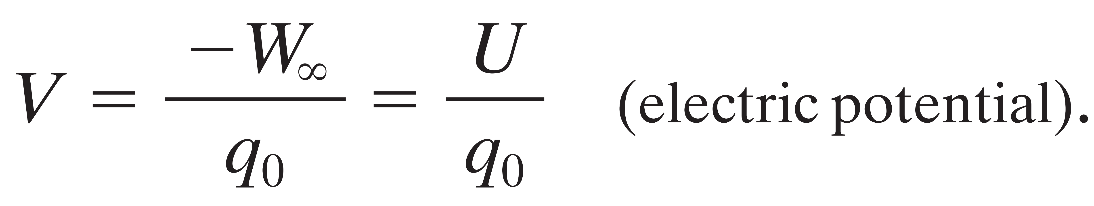
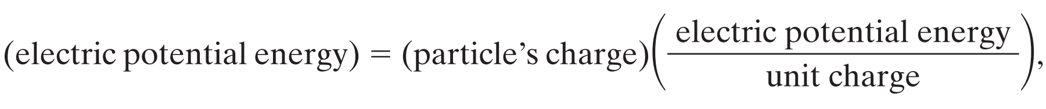
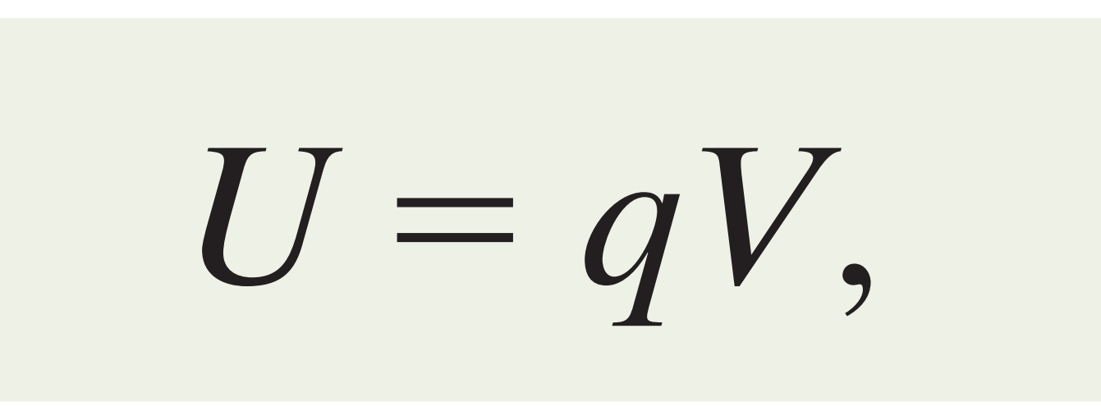
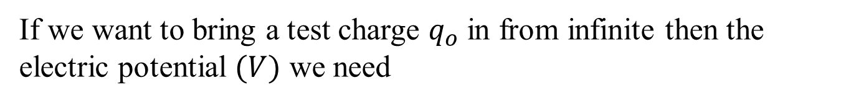
we want to find the potential energy U associated with a positive test charge q0 located at point P in the electric field of a charged rod. First, we need a reference configuration for which U = 0. A reasonable choice is for the test charge to be infinitely far from the rod, because then there is no interaction with the rod.
Potential energy = -Work
If we want to bring a test charge $q_{o}$ in from infinite then the electric potential $(V)$ we need
joule per coulomb.
where q can be positive or negative.

Slide 4


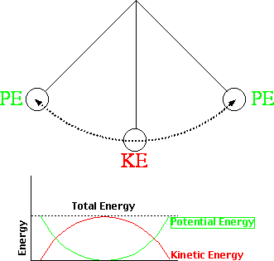
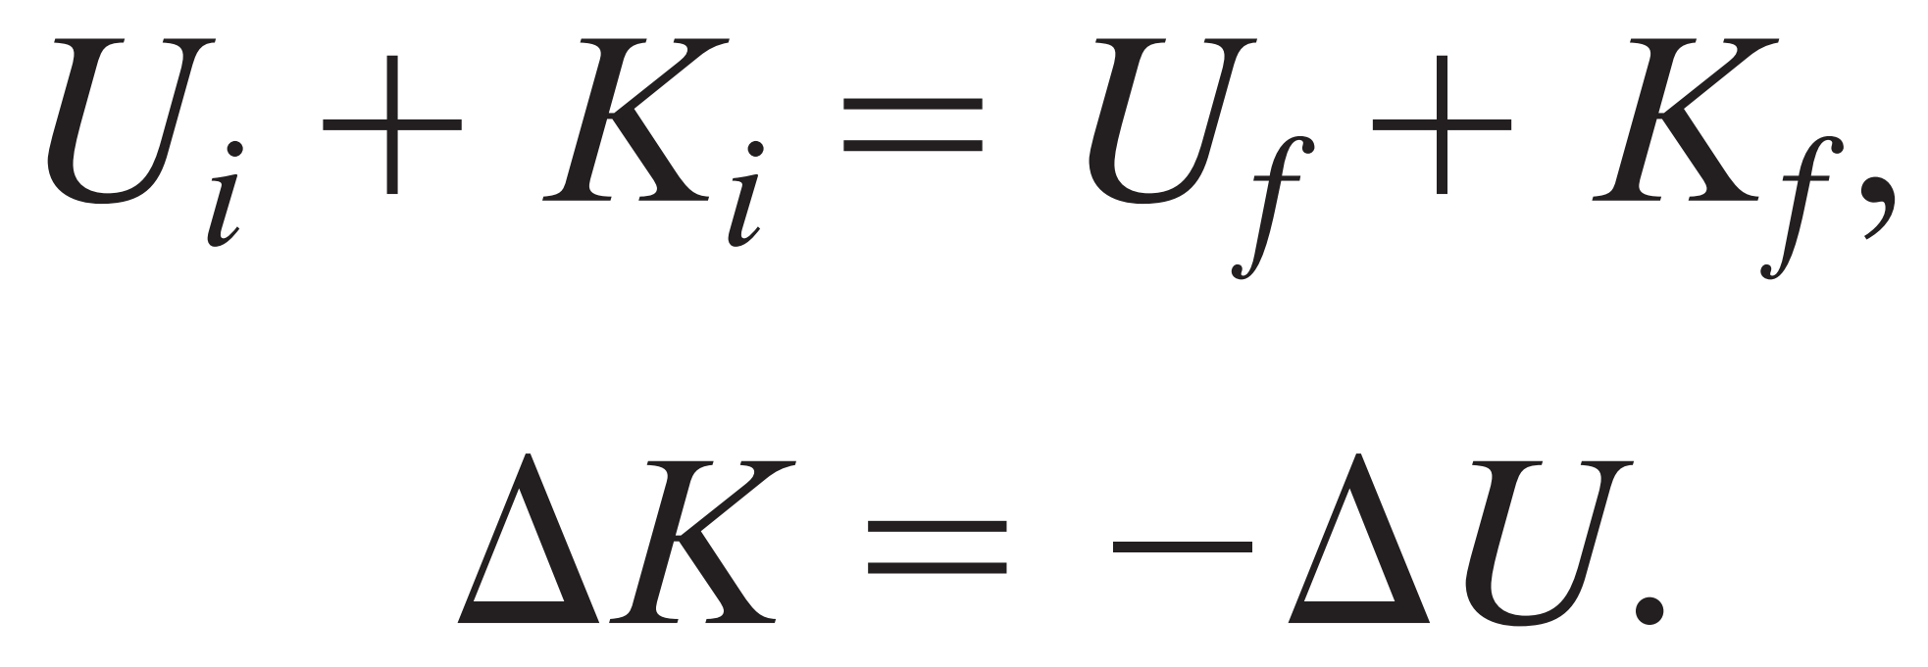
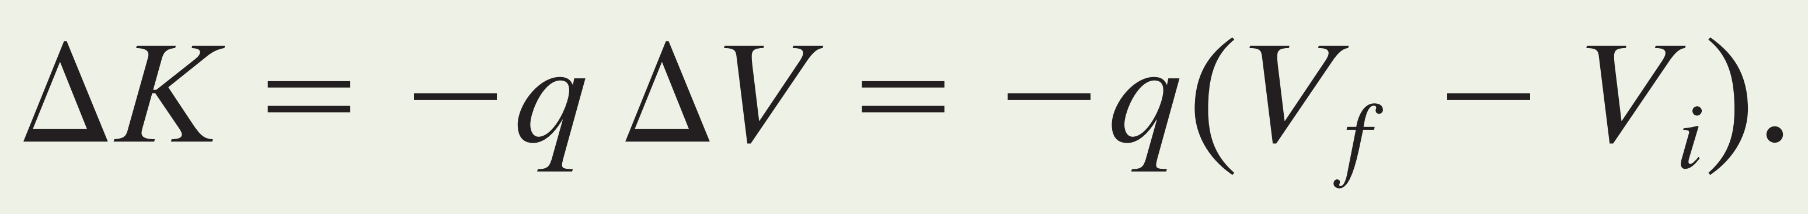
Motion Through an Electric Field
If we move from an initial point i to a second point f in the electric field of a charged object, the electric potential changes by
The electric potential
initial electric potential
finial electric potential
The potential energy
Work by the Field
Conservation of Energy
Initial energy = final energy

Slide 5
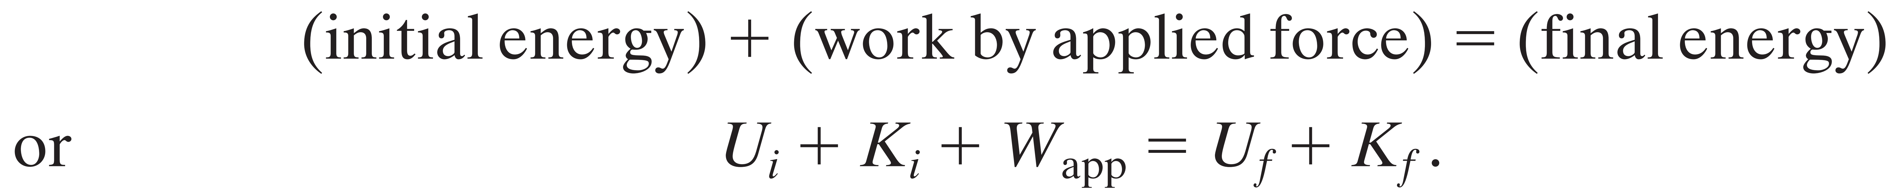

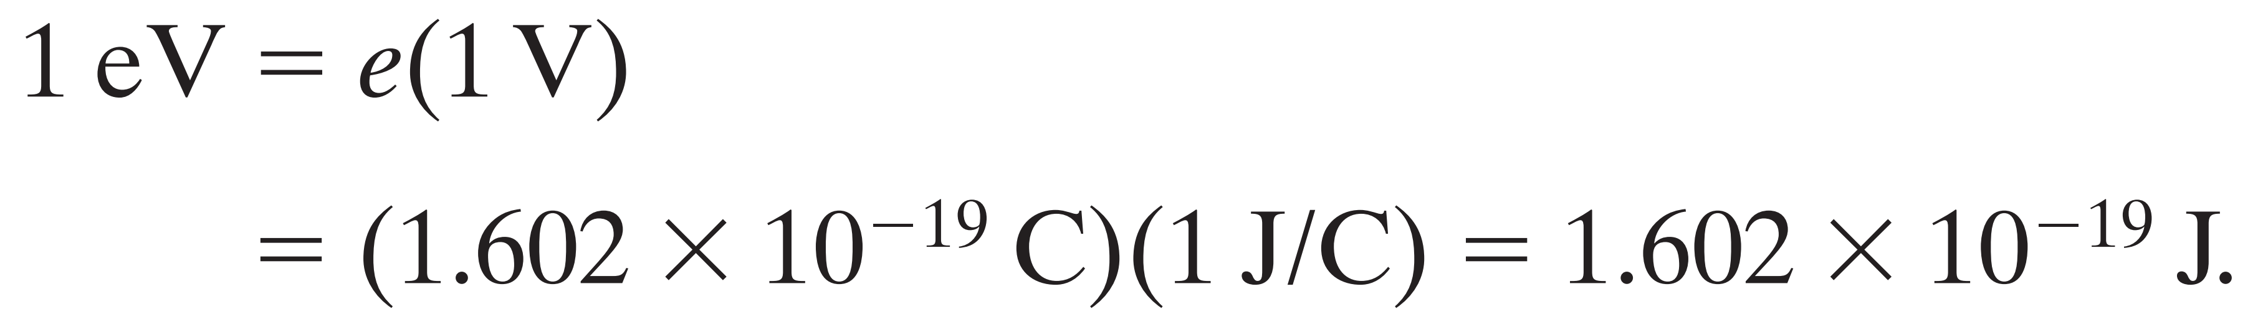
If additional force ‘external force’ act on the particle, the conservative energy will be
After rearrange
Electron-volts.
In atomic and subatomic physics, energy measures in the (International System of Units) SI unit of joules often require awkward powers of ten. A more convenient (but nonSI unit) is the electron-volt (eV), which is defined to be equal to the work required to move a single elementary charge e (such as that of an electron or proton) through a potential difference V of exactly one volt.

Slide 6
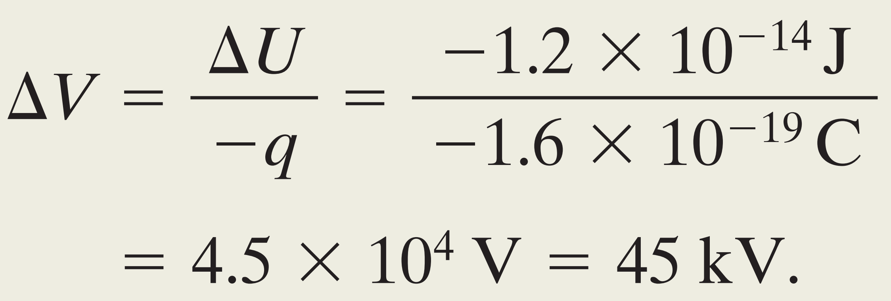
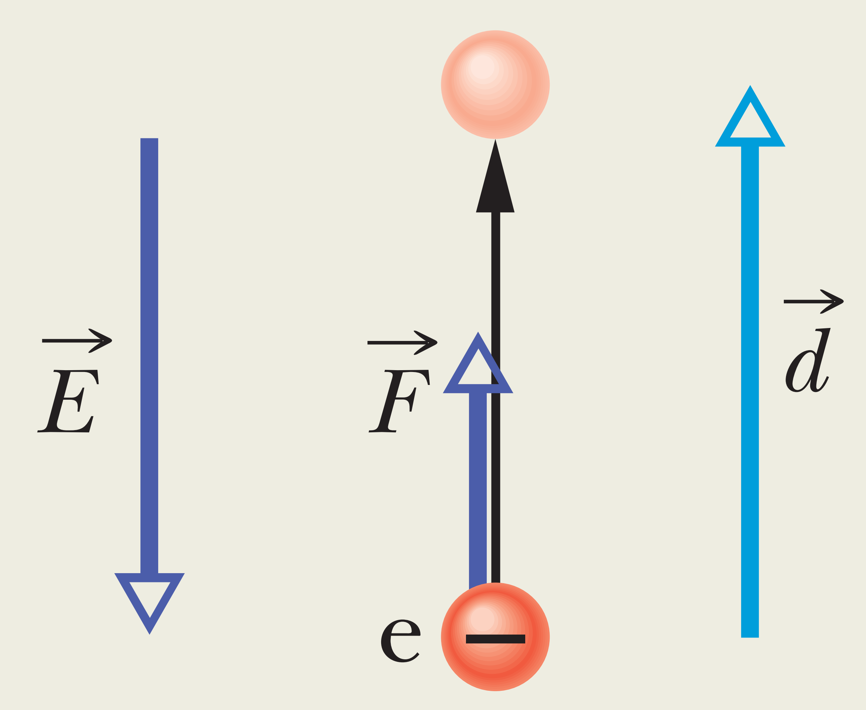

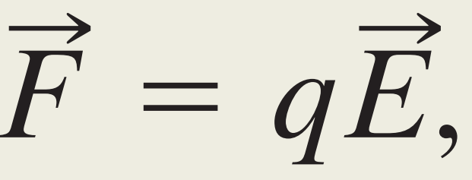

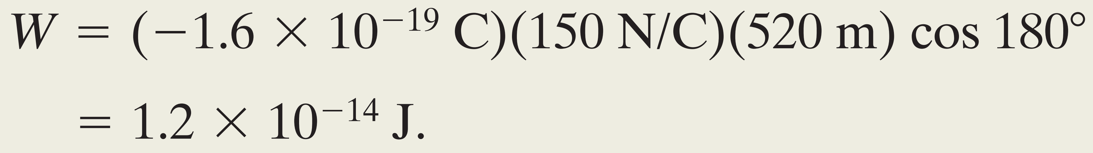

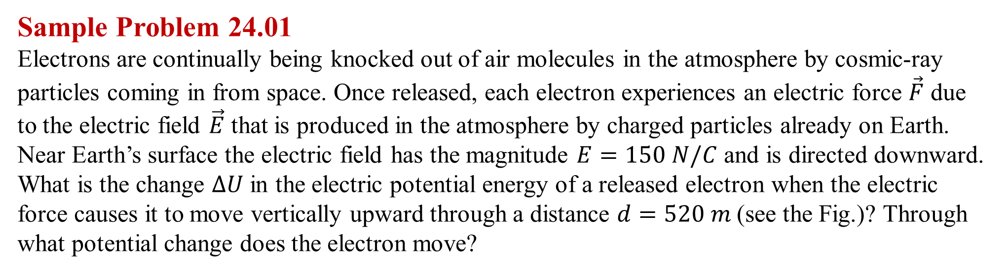
Sample Problem 24.01 Electrons are continually being knocked out of air molecules in the atmosphere by cosmic-ray particles coming in from space. Once released, each electron experiences an electric force $\vec{F}$ due to the electric field $\vec{E}$ that is produced in the atmosphere by charged particles already on Earth. Near Earth’s surface the electric field has the magnitude $E=150 N/C$ and is directed downward. What is the change $∆U$ in the electric potential energy of a released electron when the electric force causes it to move vertically upward through a distance $d=520 m$(see the Fig.)? Through what potential change does the electron move?
This tells us that the electric force does work to move the electron to a higher potential.

Slide 7
EQUIPOTENTIAL SURFACES AND THE ELECTRIC FIELD
Equipotential Surfaces
Adjacent points that have the same electric potential form an equipotential surface, which can be either an imaginary surface or a real, physical surface.

Slide 8
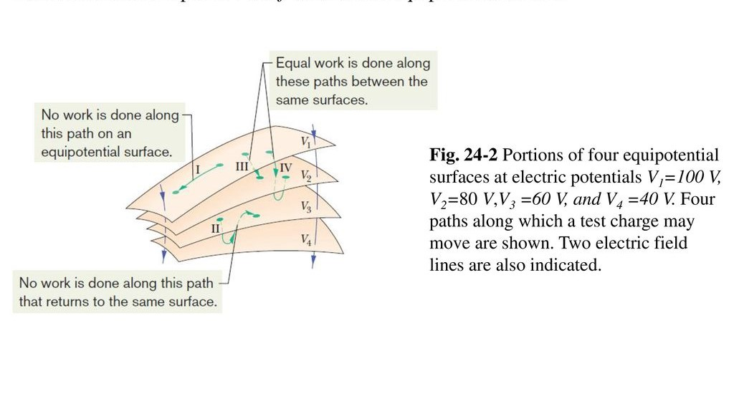
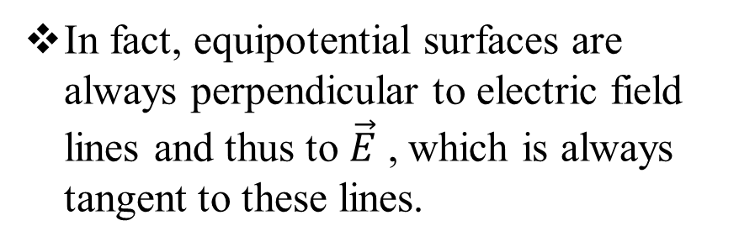
Key Ideas
The points on an equipotential surface all have the same electric potential.
No net work W is done on a charged particle by an electric field when the particle moves between two points i and f on the same equipotential surface.
The work done on a test charge in moving it from one such surface to another is independent of the locations of the initial and final points on these surfaces and of the path that joins the points.
In fact, equipotential surfaces are always perpendicular to electric field lines and thus to $\vec{E}$ , which is always tangent to these lines.

Slide 9
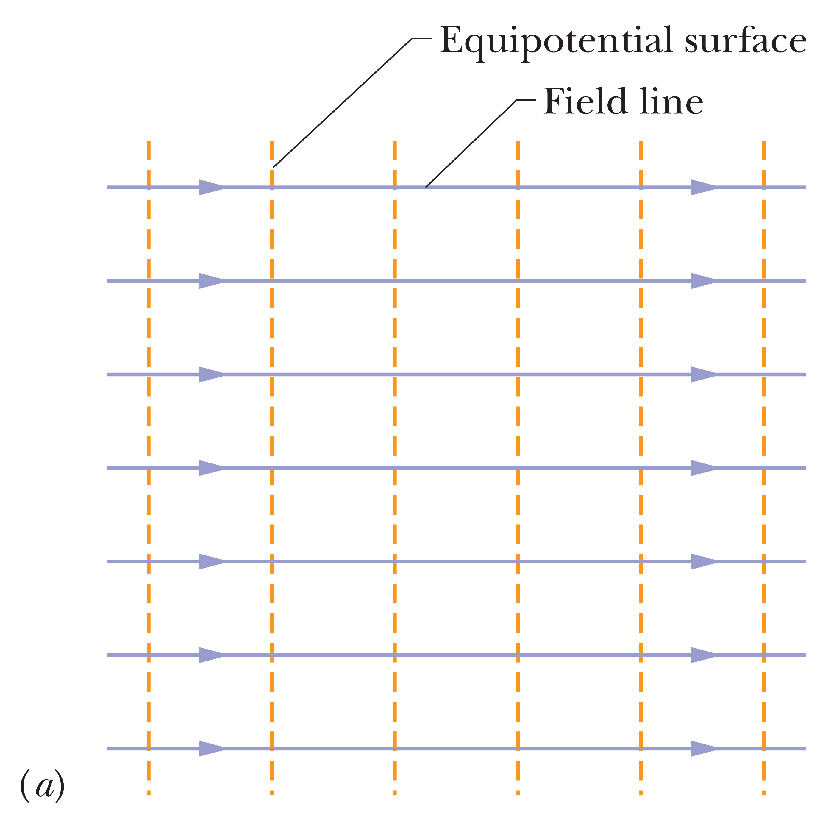
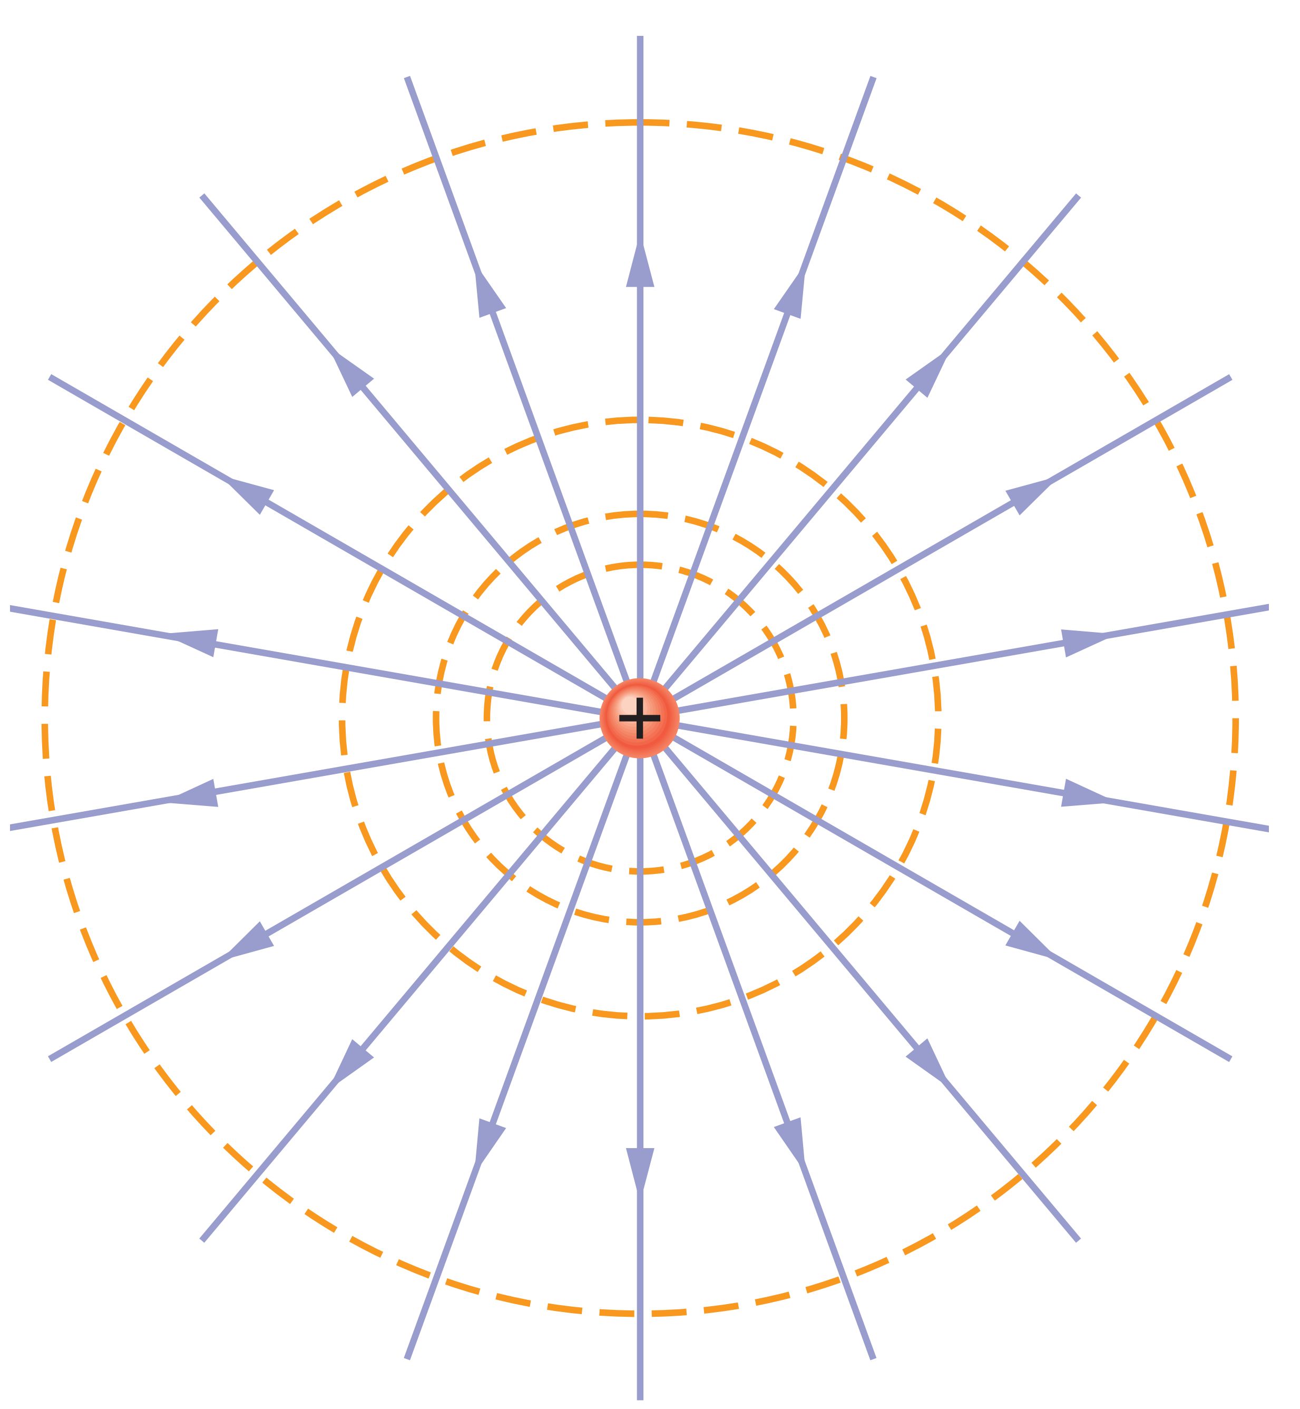
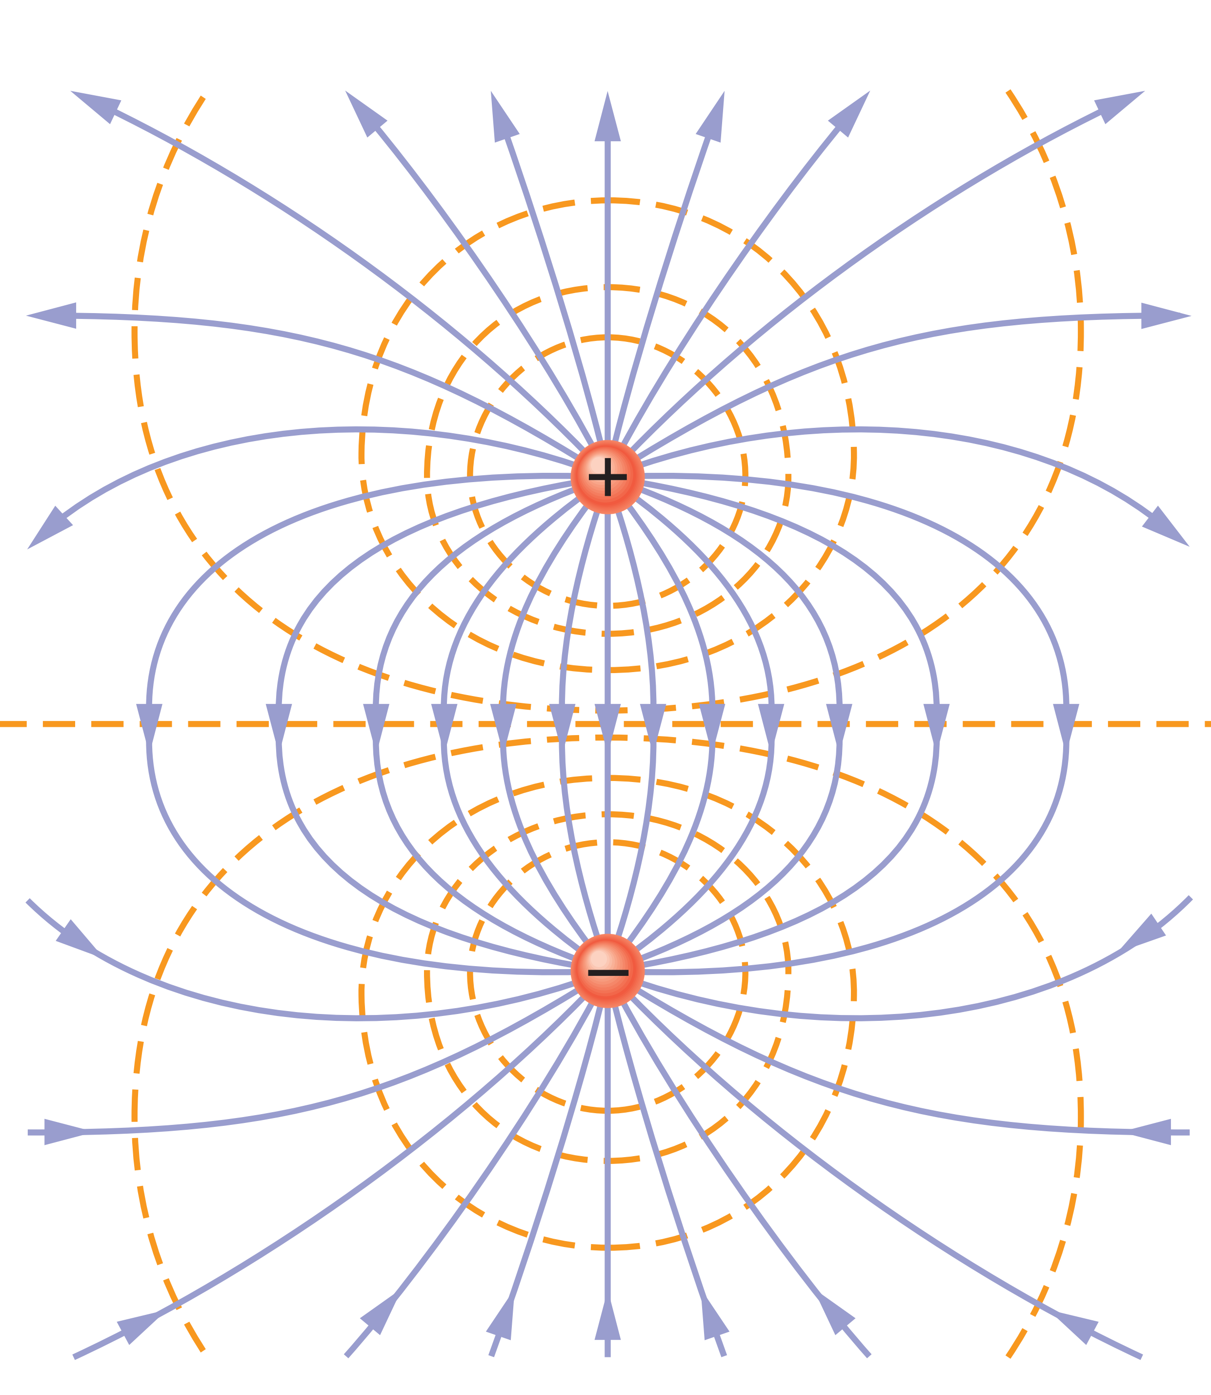
EQUIPOTENTIAL SURFACES AND THE ELECTRIC FIELD
Electric field lines (purple) and cross sections of equipotential surfaces (gold) for (a) a uniform electric field, (b) the field due to a charged particle, and (c) the field due to an electric dipole

Slide 10
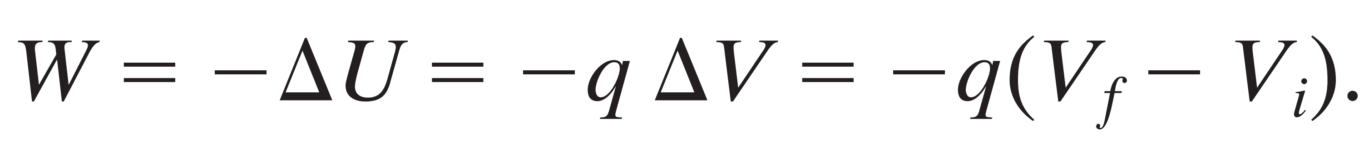
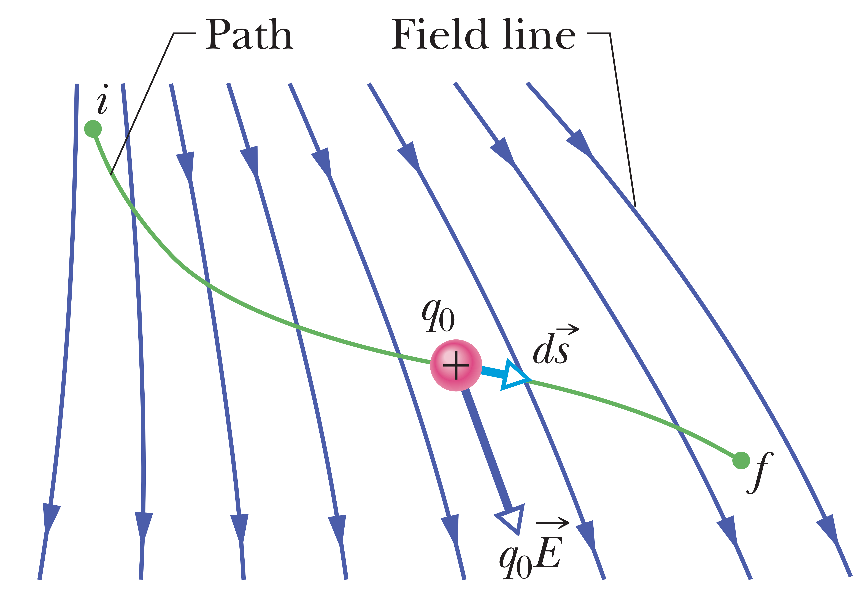
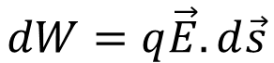

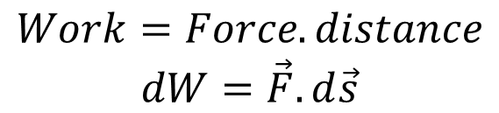
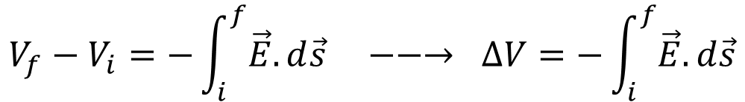
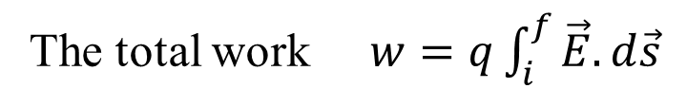
Calculating the Potential from the Field
We can calculate the potential difference between any two points i and f in an electric field if we know the electric field vector $\vec{E}$ all along any path connecting those points.
The work done by the field for a charge move from $i$ to $f$ is
Potential energy
Electric potential
$$Work=Force.distance$$
$$dW=\vec{F}.d\vec{s}$$
Electric force $\vec{F}=q\vec{E}$
Substitute Electric force in Work
$$dW=q\vec{E}.d\vec{s}$$
The total work $w=q\int_{i}^{f}{\vec{E}.d\vec{s}}$
$$V_{f}−V_{i}=−\int_{i}^{f}{\vec{E}.d\vec{s}} −−→ ∆V=−\int_{i}^{f}{\vec{E}.d\vec{s}}$$

Slide 11
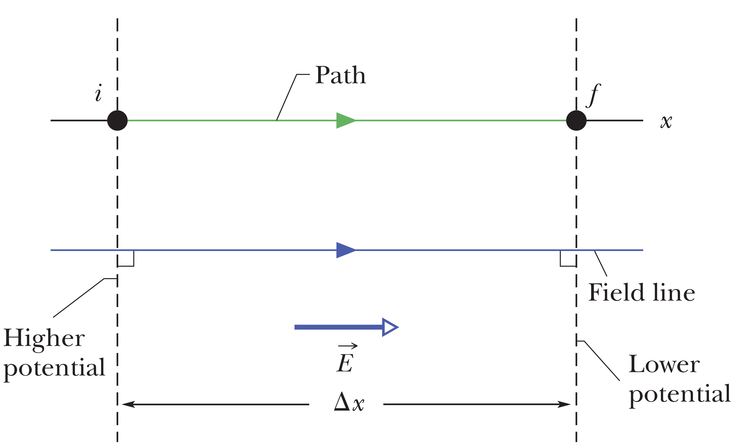
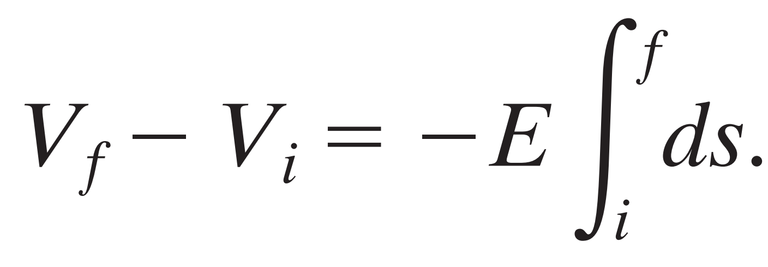
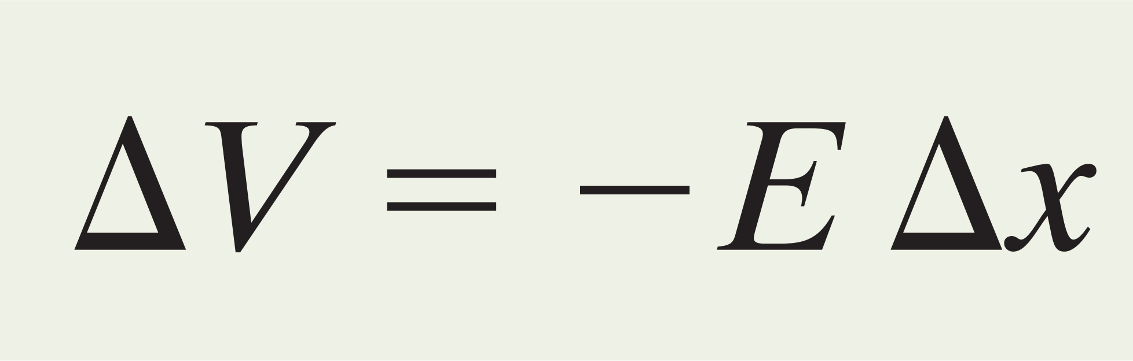
In uniform electric field
If we move in the direction of the field by distance x, the potential decreases. In the opposite direction, it increases

Slide 12
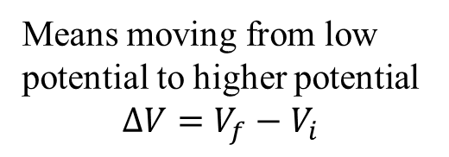
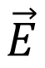
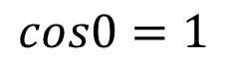
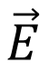
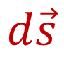

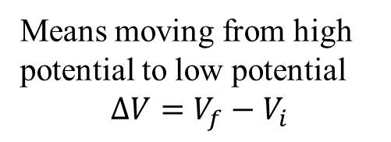
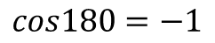
A positive charge placed in an electric field will tend to move in the direction of the field
$dW=q\int_{i}^{f}{\vec{E}.d\vec{s}},$ when $\vec{F} ⇉d\vec{s}$ work will be positive
$$\vec{E}$$
+
-
Potential Energy $∆U$ will be Negative $(W=−∆U)$
$$d\vec{s}$$
$$cos0=1$$
Kinetic Energy $∆K$ will be Positive (Gain energy), $(−∆U=∆K)$
+
Positive charge, Proton
Electric Potential $∆V$ will Decrease, $(∆V=V_{f}−V_{i})$
Means moving from high
potential to low potential
$$∆V=V_{f}−V_{i}$$
Now consider a negative charge placed in an electric field
$dW=−q\int_{i}^{f}{\vec{E}.d\vec{s}},$ when $\vec{F} ⇄d\vec{s}$ work will be positive
$$\vec{E}$$
+
-
$$d\vec{s}$$
Potential Energy $∆U$ will be Negative $(W=−∆U)$
$$cos180=−1$$
-
Negative charge, electron
Kinetic Energy $∆K$ will be Positive (Gain energy), $(−∆U=∆K)$
Electric Potential $∆V$ will Increase, $(∆V=V_{f}−V_{i})$
Means moving from low
potential to higher potential
$$∆V=V_{f}−V_{i}$$

Slide 13
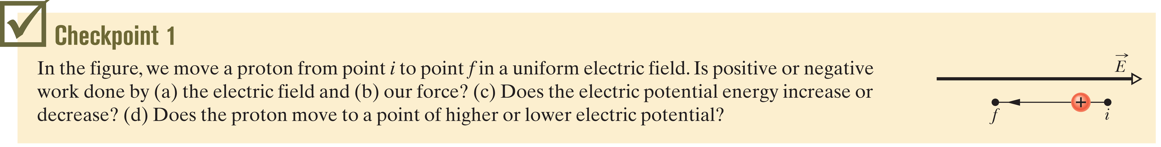
a) Negative ( opposite direction) b) Positive c) increase d) higher

Slide 14
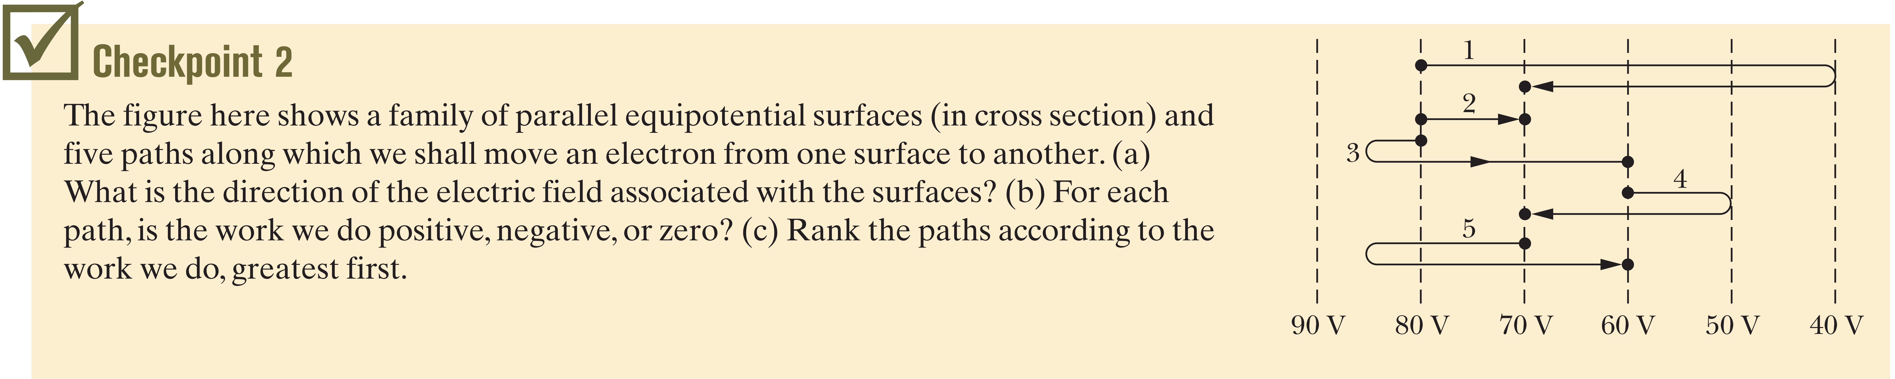
a) rightward, b) 1-2-3-5 positive; 4, negative, c) 3, (1,2,5) tie then 4
A force does positive work when it has a vector component in the same direction as the displacement, and it does negative work when it has a vector component in the opposite direction. It does zero work when it has no such vector component.

Slide 15
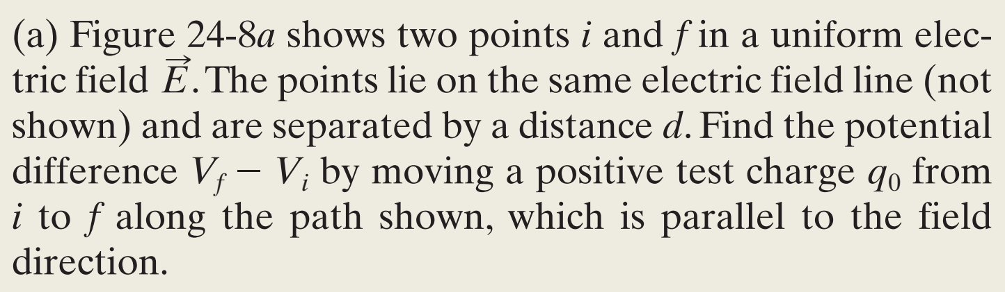
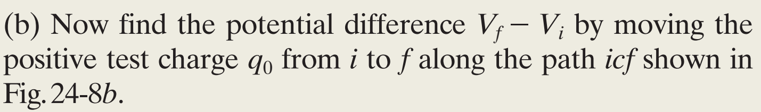

Slide 16
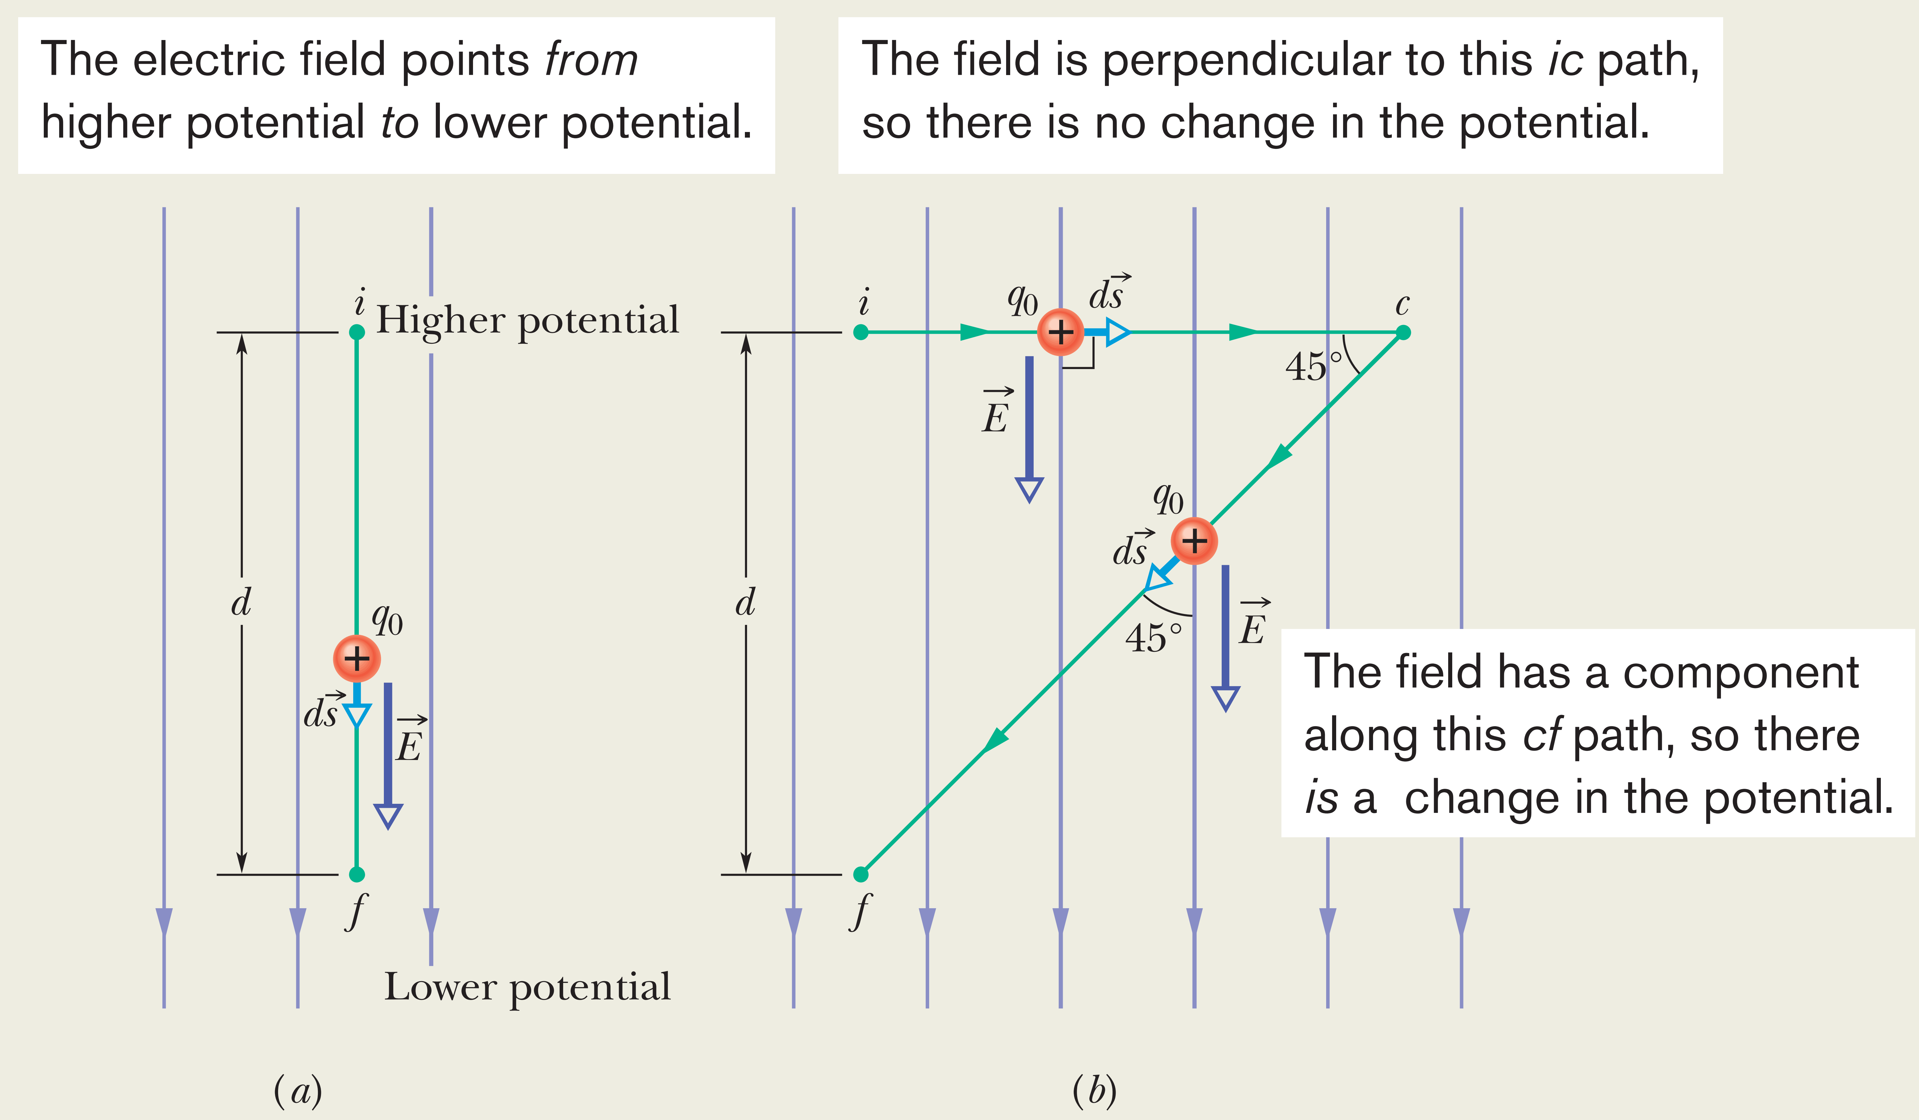
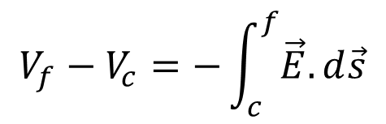
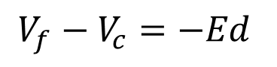
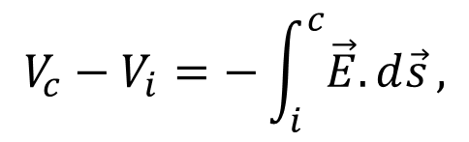
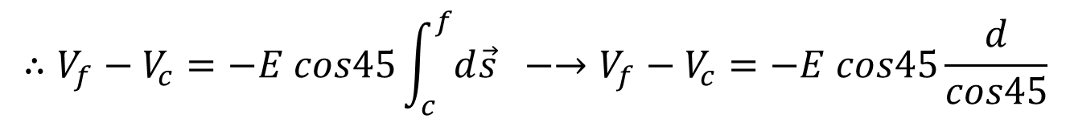
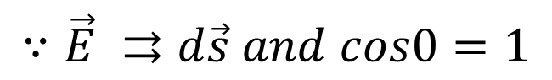
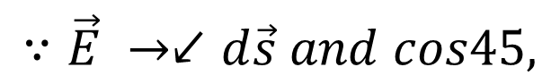




Problem 24.02
$$V_{f}−V_{i}=−\int_{i}^{f}{\vec{E}.d\vec{s}}$$
We have
Case a
$$∵\vec{E} ⇉d\vec{s} and cos0=1$$
$$∴V_{f}−V_{i}=−Ed$$
Case b
$$V_{c}−V_{i}=−\int_{i}^{c}{\vec{E}.d\vec{s}},$$
$$∵\vec{E} →↑d\vec{s} and cos90=0,$$
$$∴V_{c}−V_{i}=0$$
$$V_{f}−V_{c}=−\int_{c}^{f}{\vec{E}.d\vec{s}}$$
$$∵\vec{E} →↙d\vec{s} and cos45,$$
$$∴V_{f}−V_{c}=−E cos45\int_{c}^{f}{d\vec{s}} −→V_{f}−V_{c}=−E cos45\frac{d}{cos45}$$
$$V_{f}−V_{c}=−Ed$$
Means that the potential difference does not depends on the path.

Slide 17








POTENTIAL DUE TO A CHARGED PARTICLE
From electric field, the potential difference is
We move the test charge ${(q}_{o})$ out to infinite
$$θ=0^{o}, ds=dr$$
It is an algebraic sum, not a vector sum like the sum that would be used to calculate the electric field resulting from a group of charged particles.
$V_{f}=0 because infinite, V_{i}=V$ $E=\frac{1}{4πε_{o}}\frac{q}{r^{2}}$
For single charge
For group of charges

Slide 18





Sample Problem 24.03

Slide 19







Sample Problem 24.04
e
For a) and b), since $V$ does not depend on direction and $R$ same.
e
Because the electric field of electrons will cancel out each other field since the $E$ depends on the direction.
For a)
e
e
since $E$ it does depend on direction and $R$ same.
For b)

Slide 20


Figure shows eight particles that form a square, with
distance d between adjacent particles. What is the net
electric potential at point P at the center of the square
if we take the electric potential to be zero at infinity?
$$−\frac{4q}{4πε_{o}d}=−\frac{q}{πε_{o}d}$$

Slide 21







POTENTIAL DUE TO AN ELECTRIC DIPOLE
$p=$electric dipole moment

